Slide 1


Ishan Bhaway
9th Aug 2022

Slide 2

Outline
Executive Summary
Introduction
Methodology
Results
Conclusion
Appendix

Slide 3
Executive Summary
Summary of methodologies
Data collection through API and Webscraping
Data Wrangling
Exploratory data analysis using:
SQL
Data Visualization
Interactive Visual Analytics using Folium
Machine Learning Prediction
Summary of all results
Exploratory Data Analysis results
Interactive analytics dashboard screenshots
Predictive Analysis outcome

Slide 4
Introduction
Project background and context
In this capstone, we will predict if the Falcon 9 first stage will land successfully. SpaceX advertises Falcon 9 rocket launches on its website with a cost of 62 million dollars; other providers cost upward of 165 million dollars each, much of the savings is because SpaceX can reuse the first stage. Therefore if we can determine if the first stage will land, we can determine the cost of a launch. This information can be used if an alternate company wants to bid against SpaceX for a rocket launch.
Problems you want to find answers
Identify the factors that will influence the landing
Relationship between each of the factors and the kind of influence they have on the landing outcome
Predicting the best factors/conditions needed for the better probability of successful landing

Slide 5

Section 1

Slide 6
Methodology
Executive Summary
Data collection methodology:
Data was collected using SpaceX REST API and webscrapping from Wikipedia
Perform data wrangling
One hot encoding was performed on the categorical features present in data collected
Restricting to only required/necessary columns
Perform exploratory data analysis (EDA) using visualization and SQL
Perform interactive visual analytics using Folium and Plotly Dash
Perform predictive analysis using classification models
How to build, tune, evaluate classification models

Slide 7
Data Collection
Describe how data sets were collected.
Data sets are collected from Space X API for:
https://api.spacexdata.com/v4/rockets/ - Rockets
https://api.spacexdata.com/v4/launchpads/ - LaunchPads
https://api.spacexdata.com/v4/payloads/ - Payloads
https://api.spacexdata.com/v4/cores/ - Cores
You need to present your data collection process use key phrases and flowcharts

Slide 8
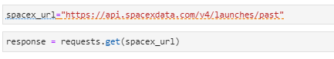
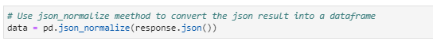
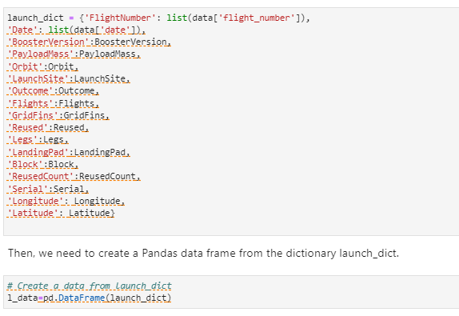
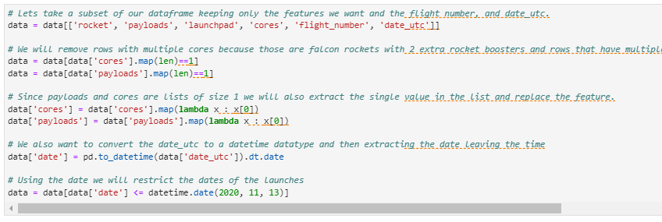
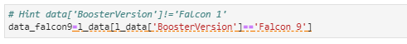
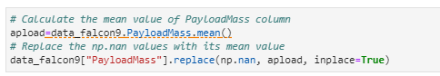
Data Collection – SpaceX API
Request (SpaceX APIs)
Convert to the dataframe from JSON using .json_normalize
Create dictionary based on the data from payloads, rocket, launchpad, cores, flight number and convert the same in to dataset
Filter data for Falcon 9 launches
Impute missing payload mass with mean value
URL : https://github.com/ishanbhaway/testrepo/blob/923f92a569e50bdbf02e61f12a9d01d1e5ec9b6c/jupyter-labs-spacex-data-collection-api.ipynb

Slide 9
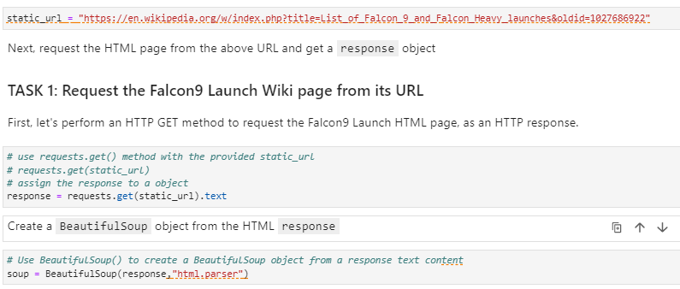
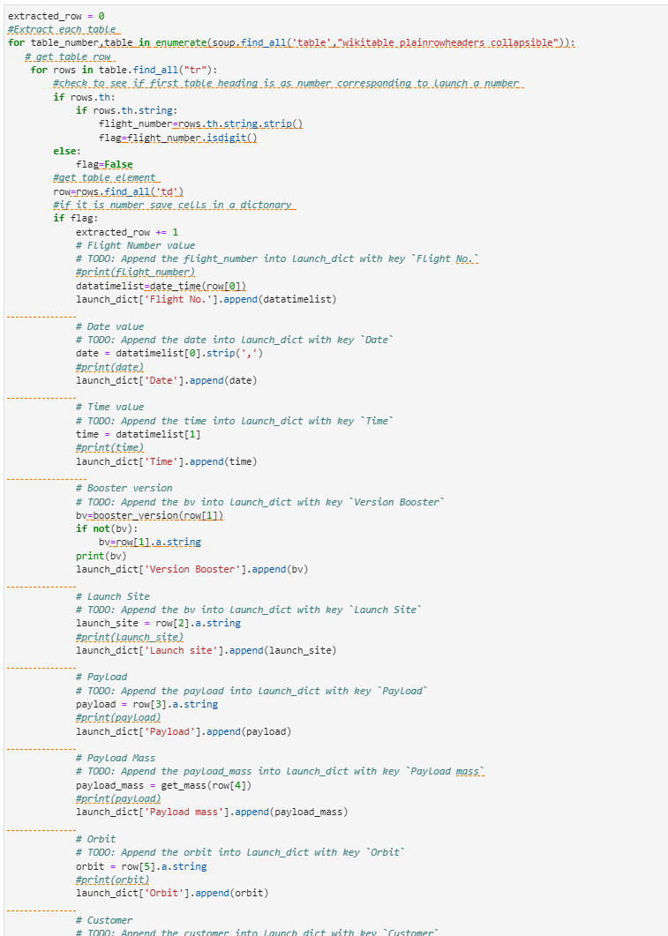
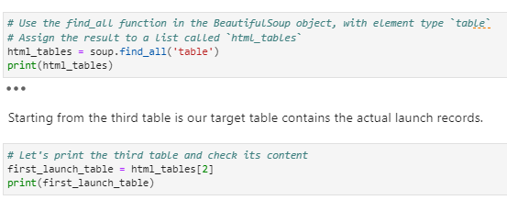
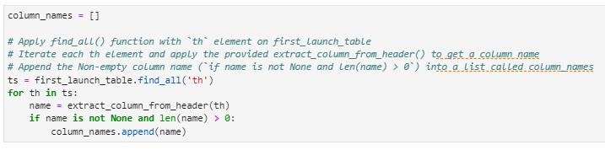
Data Collection - Scraping
Request Wikipedia html url for Falcon 9
Read Data using Beautiful Soup
Extract column/variable based on HTML Table Header
Create a data frame by Parsing the launch HTML table
URL : https://github.com/ishanbhaway/testrepo/blob/923f92a569e50bdbf02e61f12a9d01d1e5ec9b6c/jupyter-labs-webscraping.ipynb

Slide 10
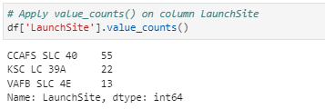
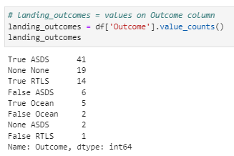
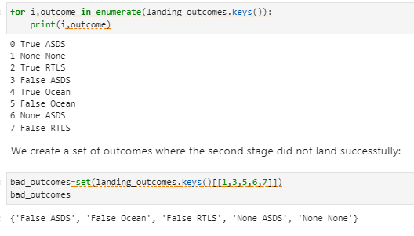
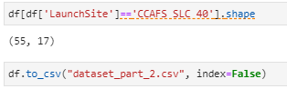
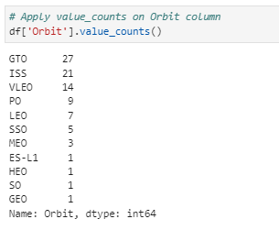
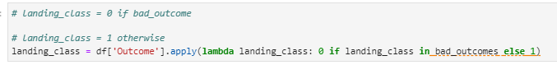
Data Wrangling
Converting Outcomes into Training labels:
1 – successful landing – True Ocean, True ASDS
0 – failure landing – False RLTS, False ASDS
Calculate the number of Launches
Calculate the number and occurrence of each orbit
Calculate the number and occurence of mission outcome per orbit type
Create a landing outcome label from Outcome column
URL : https://github.com/ishanbhaway/testrepo/blob/923f92a569e50bdbf02e61f12a9d01d1e5ec9b6c/labs-jupyter-spacex-Data%20wrangling.ipynb

Slide 11
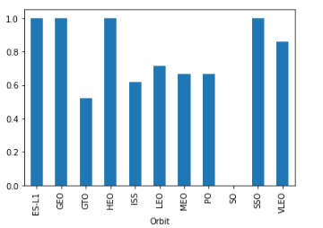
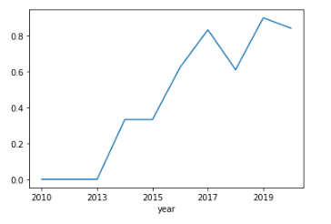
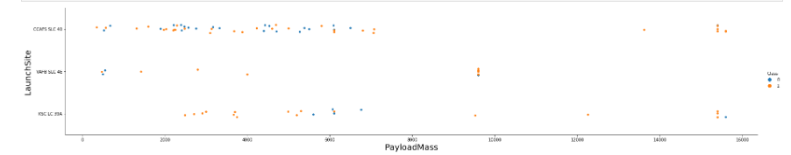
EDA with Data Visualization
Scatter Graph: To plot relationship between variables
Flight Number and Payload Mass
Flight Number and Launch Site
Payload and Launch Site
FlightNumber and Orbit type
Payload and Orbit type
Bar Graph: To plot relationship between Categorical variable and corresponding values against a particular variable
Success rate of each orbit type
Line Graph: To plot trend of a variable for a given case – can be used for comparison
Success yearly trend
URL : https://github.com/ishanbhaway/testrepo/blob/923f92a569e50bdbf02e61f12a9d01d1e5ec9b6c/jupyter-labs-eda-dataviz.ipynb

Slide 12
EDA with SQL
Display the names of the unique launch sites in the space mission
Display 5 records where launch sites begin with the string 'CCA'
Display the total payload mass carried by boosters launched by NASA (CRS)
Display average payload mass carried by booster version F9 v1.1
List the date when the first succesful landing outcome in ground pad was acheived.
List the names of the boosters which have success in drone ship and have payload mass greater than 4000 but less than 6000
List the total number of successful and failure mission outcomes
List the names of the booster_versions which have carried the maximum payload mass. Use a subquery
List the records which will display the month names, failure landing_outcomes in drone ship ,booster versions, launch_site for the months in year 2015.
Rank the count of successful landing_outcomes between the date 04-06-2010 and 20-03-2017 in descending order.
URL : https://github.com/ishanbhaway/testrepo/blob/923f92a569e50bdbf02e61f12a9d01d1e5ec9b6c/jupyter-labs-eda-sql-coursera_sqllite.ipynb

Slide 13
Build an Interactive Map with Folium
Markers and circle indicates launch sites – like NASA Johnson Space Center
Grouping of data points in a cluster considering they refer to same coordinates
Green indicates successful and Red indicates Failure in landing
Line markers indicates between launch site and respective locations – coast, railways etc
The markers assist in understanding the data in reference to live maps
URL : https://github.com/ishanbhaway/testrepo/blob/923f92a569e50bdbf02e61f12a9d01d1e5ec9b6c/lab_jupyter_launch_site_location.ipynb

Slide 14
Build a Dashboard with Plotly Dash
Graphs and plots –
Successful Launches by Site
Payload and Success by sites
This allows quick assessment of the relationship between payload, launch sites and successful launches
URL : https://github.com/ishanbhaway/testrepo/blob/923f92a569e50bdbf02e61f12a9d01d1e5ec9b6c/spacex_dash_app.py

Slide 15
Predictive Analysis (Classification)
Data Preparation
Load dataset
Data transformation
Model Generation
Configure the parameters for GridSearchCV
Apply the respective parameters on the Machine learning algorithms
Model Evaluation
Identify the best parameters for the respective model
Assess each model’s accuracy based on the test dataset
Model Comparison
Standardize dataset
Splitting the datasets into train and test sets
Train the models with train datasetds
Generate Confusion matrix basis the same
Compare the models accuracy for selection of the model applicable
URL : https://github.com/ishanbhaway/testrepo/blob/a439e423c99a2e5603ec37e30456a30459c8c51e/SpaceX_Machine%20Learning%20Prediction_Part_5.ipynb

Slide 16
Results
Exploratory data analysis results
Interactive analytics demo in screenshots
Predictive analysis results

Slide 17

Section 2

Slide 18
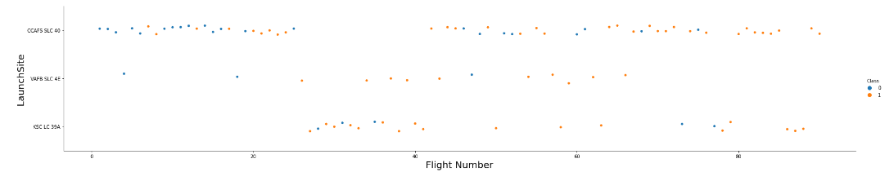
Flight Number vs. Launch Site
Failures tend to decrease over time and Success increase over time
CCAF5 SLC 40 has most number of launches also holds most number of success

Slide 19
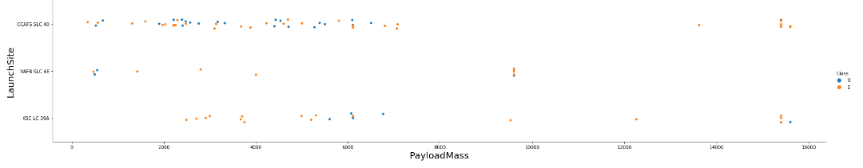
Payload vs. Launch Site
The Success rate is observed to be higher in cases where the Payload is higher

Slide 20
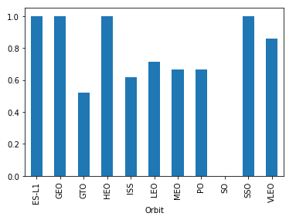
Success Rate vs. Orbit Type
While SSO, HEO, GEO and ES-L1 have 100% success rate; it is to be noted that ES-L1, GEO and HEO have done only one launch

Slide 21
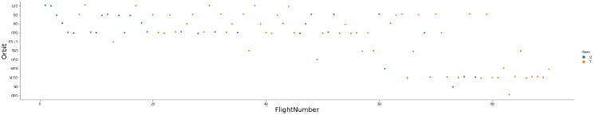
Flight Number vs. Orbit Type
Success rate has improved for all orbits over time relatively
VLEO orbit even though recent can be observed can be considered with higher success rate

Slide 22
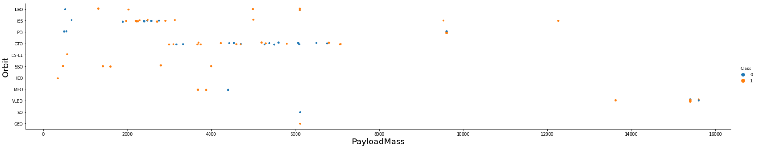
Payload vs. Orbit Type
There is no clear pattern associated with orbit type and Payload
Except ISS, most of the orbit type are concentrated towards in specific range of payload

Slide 23
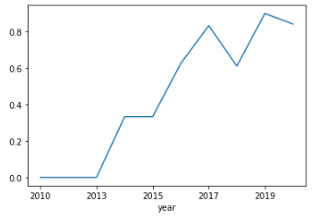
Launch Success Yearly Trend
Success rate significantly rose in 2013 and started stabilizing in year 2017

Slide 24
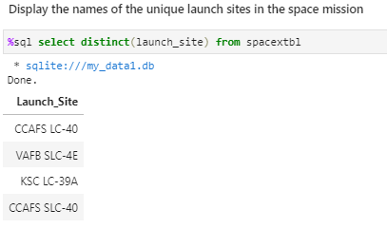
All Launch Site Names
Use Distinct to get unique Launch sites

Slide 25
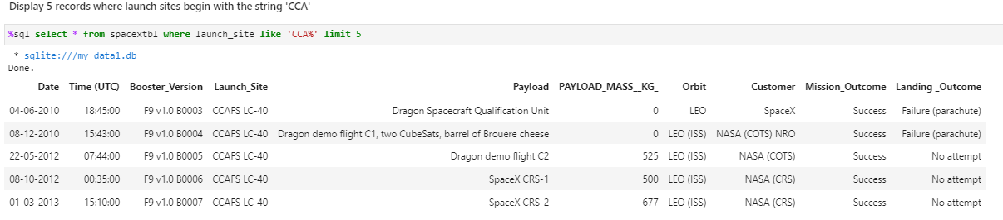
Launch Site Names Begin with 'CCA'
Use limit 5 for top 5 statements and “CCA%” with WHERE clause to filter the data starting with CCA

Slide 26
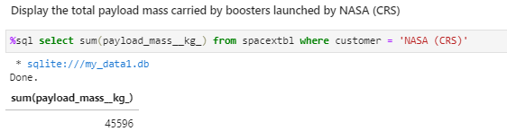
Total Payload Mass
Use Customer as “NASA (CRS)” for payload masses

Slide 27
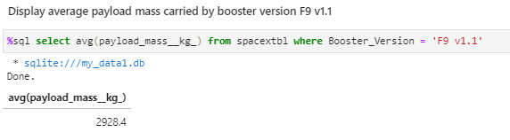
Average Payload Mass by F9 v1.1
Use WHERE query to identify booster version

Slide 28
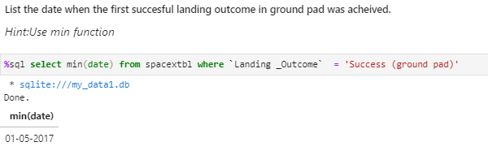
First Successful Ground Landing Date
Use MIN() function to get the result

Slide 29
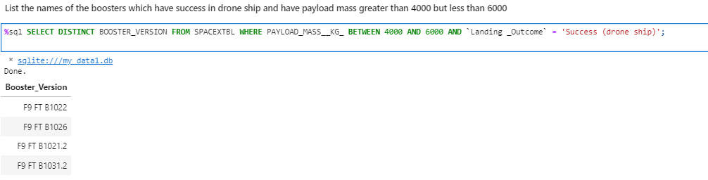
Successful Drone Ship Landing with Payload between 4000 and 6000
List the names of boosters which have successfully landed on drone ship and had payload mass greater than 4000 but less than 6000, using BETWEEN clause and other WHERE clauses

Slide 30
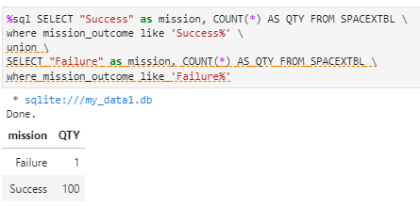
Total Number of Successful and Failure Mission Outcomes
Calculate the total number of successful and failure mission outcomes using WHERE clause along with UNION

Slide 31
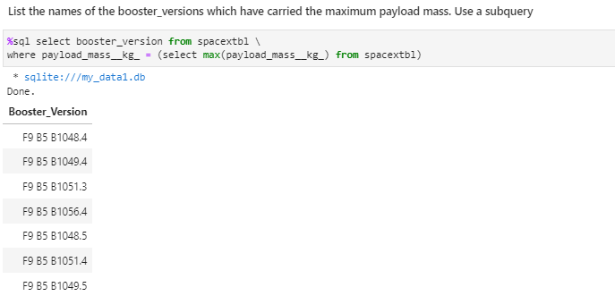
Boosters Carried Maximum Payload
Use sub query with MAX function to filter data using WHERE clause

Slide 32
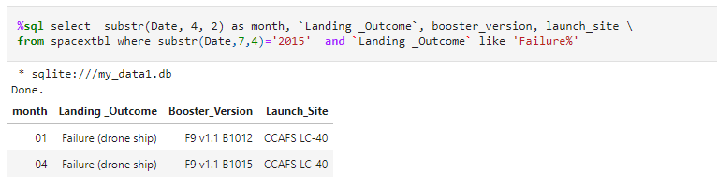
2015 Launch Records
Use SUBSTR to identify the year 2015 based on year position in the respective date format alongwith Failure filter

Slide 33
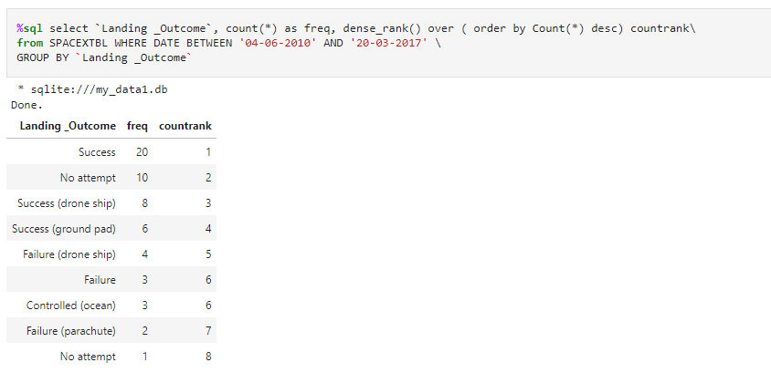
Rank Landing Outcomes Between 2010-06-04 and 2017-03-20
Use the Count upon grouping landing outcomes (such as Failure (drone ship) or Success (ground pad)) between the date 2010-06-04 and 2017-03-20. This is followed by using Dense_Rank in descending order on Count

Slide 34

Section 3

Slide 35
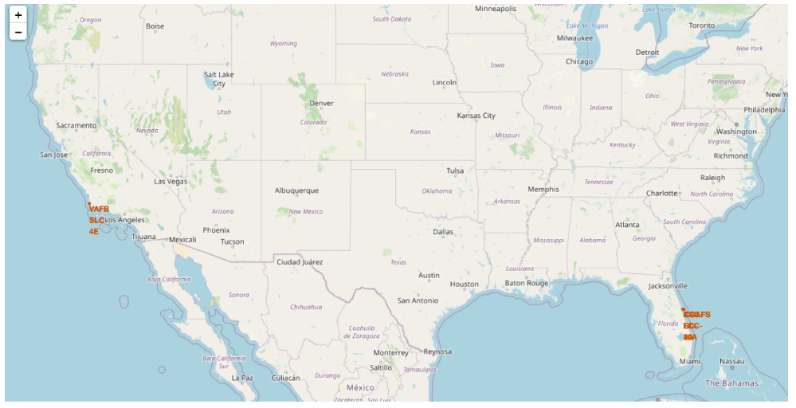
Location of launch Sites
All are within US South coastal region indicating:
the closeness to equator being targeted to get most benefit of earth’s rotation
safety in instance of failure the rocket to be crash landed in sea to avoid US asset and human damage

Slide 36
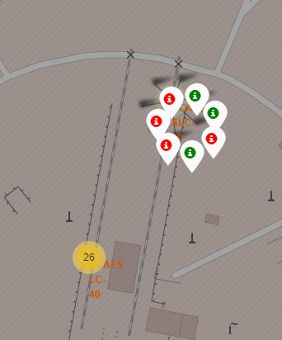
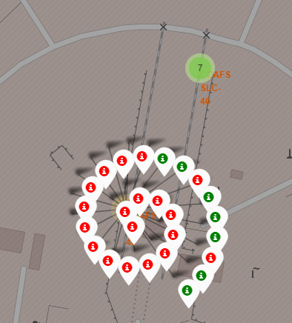
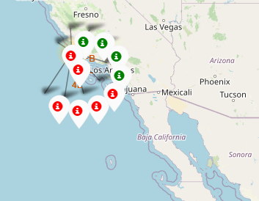
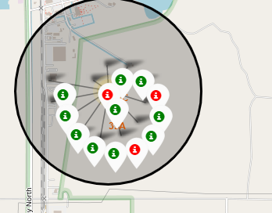
Launch sites Markers with color labels
Green indicates successful launches
Red indicates failures

Slide 37
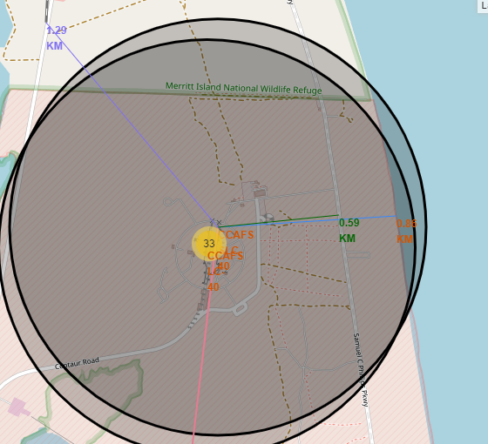
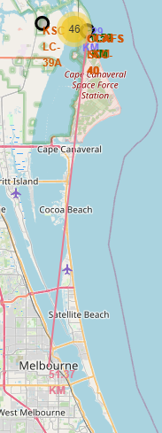
Launch sites distance from Landmarks
Launch sites are extremely close to coastline as compared to any other major infrastructure like railways and even major cities

Slide 38

Section 4

Slide 39
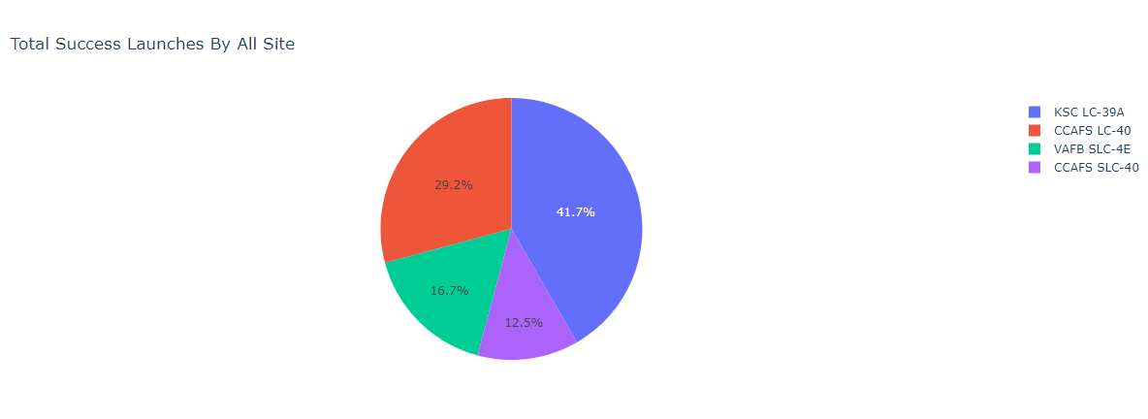
Success percentage by each sites
KSC LC-39A is the most successful among all sites

Slide 40
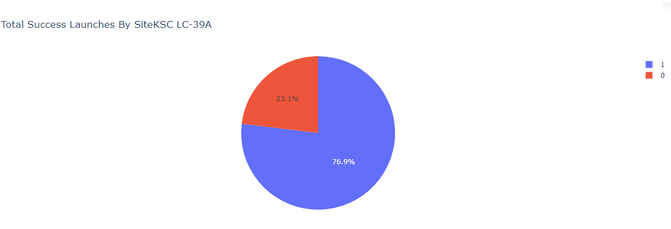
Pie Chart showing the most successful Launch Site: KSC LC-39A
KSC LC-39A with success rate of 76.9% and 23.1% failure rate

Slide 41
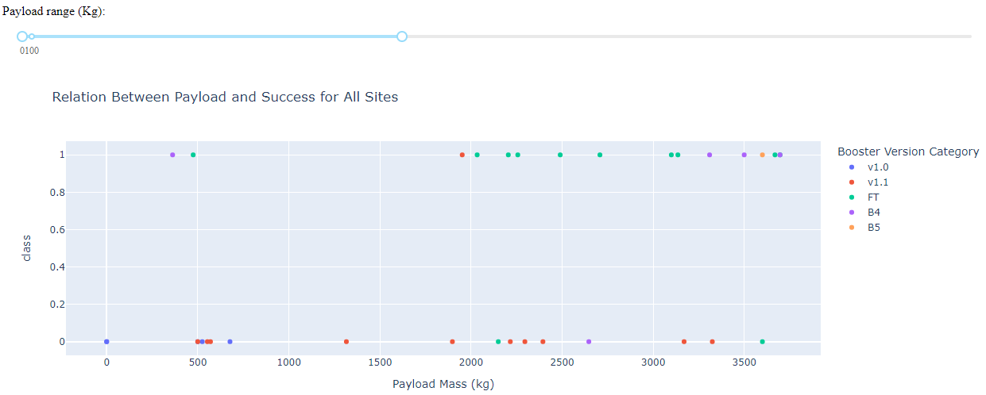
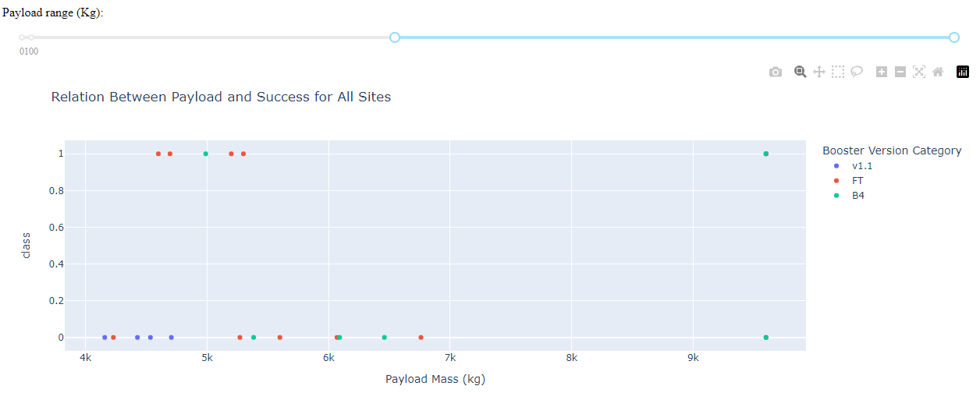
Payload vs. Launch Outcome scatter plots
Low Payload launches were most successful
FT booster version category is most successful

Slide 42

Section 5

Slide 43
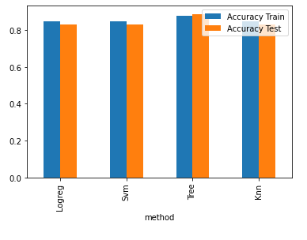
Classification Accuracy
Decision tree has the highest classification accuracy

Slide 44
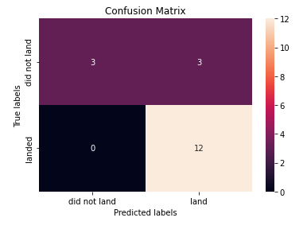
Confusion Matrix – Decision Tree
While best in terms of accuracy, considering the situation in matter – 3 false positives – failures predicted as successful landing

Slide 45
Conclusions
Success rates increased over time
SSO and VLEO to be key opportunity considering high success rates
Success rates increased significantly from 2013 and right now stabilizing
Launch sites are closer to coastline and equator
KSC LC-39A most successful launches
Decision Tree is best classifier

Slide 46
Appendix
Libraries used:
Numpy
Pandas
Folium
Seaborn
Dash
Plotly
SQLite
BeautifulSoup
Re
Requests
Sklearn

Slide 47


